Slide 1
Multiplayer & Online games
Introduction to Game Design and Development
ITCS 4230/5230
Dr. Dewan Tanvir Ahmed
Department of Computer Science
University of North Carolina at Charlotte

Slide 2
Objectives
Basic concepts in multiplayer & online games
Game Architectures
Area of Interest Management
MMOGs business model
Game State and Dead Reckoning

Slide 3
Multiplayer Computer Games
More than one person can play the same game at the same time.
Approach used
require the players to gather around a single game system to play
computer networking to allow players to play together or
Player versus player or PvP:
players either all compete against each other
Co-operative gaming
team up to achieve a common goal such as defeating an enemy that can consist of either computer or human players

Slide 4
Multiplayer Computer Games
Practiced approaches for multiplayer games:
Split Screen
Single Area Play
Turn-based Game

Slide 5
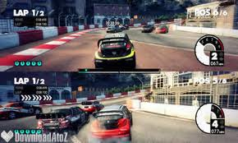
Multiplayer Computer Games
Split-screen games
These games give each player an individual viewpoint
Support up to 2 players
Dirt 3: Dirt/rally racing game split screen (Youtube)
Support up to 4 players
Blur: Arcade racing game split screen
Bitfighter: One machine can support multiple play windows (joystick mode only, up to 4 players tested)

Slide 6
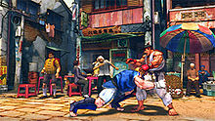
Multiplayer Computer Games
Single play area
These games show one view of the action with all players
Example: Street Fighter

Slide 7
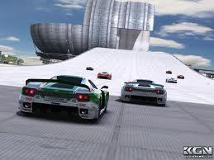
Multiplayer Computer Games
Turn-based games
These hotseat games allow players to take turns using a single controller
A multiplayer mode which allows two or more players to play on the same device by taking turns playing the game
Example: TrackMania

Slide 8
History
1969, Spacewar – two player
1975, Dungeon
1978, MUD 1
1986, Habitat
Graphic, up to 64 players
1993, Doom
1997, Ultima Online
1998, Lineage
2004, WoW

Slide 9
Multiplayer Computer Games
Types of MOG: Categorization by Genre
First-Person Shooter (FPS)
Role-Playing Game (RPG)
Real-Time Strategy (RTS)
Scales of MOG
N = Number of players in a game world
N >1000 ➔ Massively Multiplayer (MMOG)

Slide 10
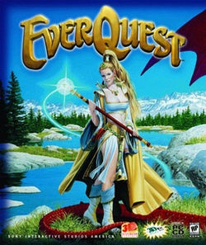
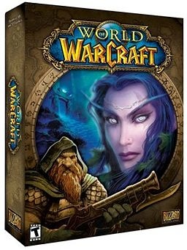
MMOG - Massively Multiplayer Online Games
A kind of Network Virtual Environment
combines graphics, animations and networking - create a game world
Example:
World of warcrafts
Sony’s EverQuest
Valve’s Half-life
Some features!
Persistence of data - Achievements persist, and “world goes on” even if the player is offline
Vastness of environment?
Open-endedness of gameplay?

Slide 11
Introduction to Online Games
3 Primary Online Games:
World of Warcraft
Final Fantasy XI Online
EverQuest
These are called MMORPGs – Massive Multiplayer Online Role Playing Games
MMORPGs never end, there isn’t a final goal state which you can achieve.
You ultimately strive to be the best of the best within the game.

Slide 12
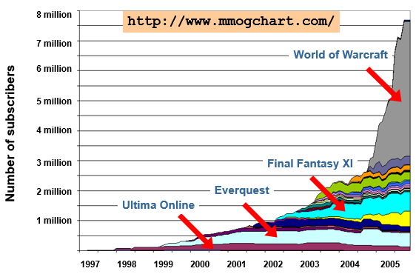
MMOGs are Huge!
https://infogr.am/MMO-Population-by-year

Slide 13
Why addiction is a problem?
Shawn Woolley – A 21 year old man from Hudson, WI who committed suicide from stress caused by a personal friend within the game EverQuest.₂
A Korean couple left their 4 month old child alone to suffocate and die, because they were playing World of Warcraft at a local internet café for too long. “We were thinking of just playing for an hour or two like usual, but the game took longer that day”₃
(“Death of a Game Addict,” para. 2)
(Gamespot, 2005)

Slide 14
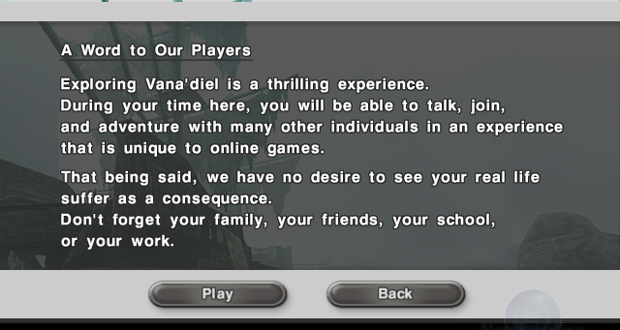
A disclaimer from Final Fantasy XI (Displayed every time before logging into the game)

Slide 15
Troublesome Players
Bullies, con artists, spoilers, verbally abrasive people, etc.
Solutions
Ignore
Create safe areas or no-attack flags
Police using Customer Support
Police using players
Can create new bullies

Slide 16
MMOG Design
RPG, RTS, FPS, etc.
Teaming up against NPCs
Trading items
Virtual economy
Customizing game
Performance issues
Fighting against each other
Player against player (PvP)
Lord of the flies!
Internet
Cheat sites, extensions, scripts, etc.

Slide 17
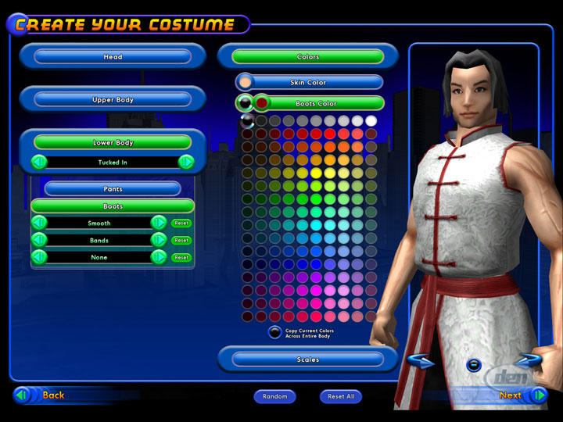
Example: City of Heroes
Youtube

Slide 18
Objectives
Basic concepts in multiplayer & online games
Game Architectures
Area of Interest Management
MMOGs business model
Game State and Dead Reckoning

Slide 19
Game Architectures
Peer-to-peer
Client/Server
One server per game
Floating server
One client is also a server
Distributed server
Multiple servers for large world

Slide 20
Game Architectures (cont.)
Peer-to-Peer - Simple version: Lockstep
e.g. Doom
Each client transmits to other
Wait for everyone to get data
Proceed to next step
Advantages
Simple
Nobody has to provide a server
Good for turn-based games with low bandwidth
TCP
Disadvantages
Frame rate is that of
Slowest machine
Worst connection
Hackable
Not good for real-time games

Slide 21
Game Architectures (cont.)
Client/Server - Server per game
MUDs, Fireteam, NetTrek
Someone must provide server ($$$)
Possibly the game’s authors
Less hackable
Single point of failure
Server must be big & well-connected

Slide 22
Floating Server
Peer-to-peer
Server resolves the action
One peer is the server
Unreal
One player elects to be the server
X-Wing vs Tie-Fighter:
First player to enter session
Starcraft
Player with the CD

Slide 23
Multiple Servers
Many machines coordinate service
Ultima Online, Everquest, AOL
Used for large virtual worlds
Everquest
One server per game-geographic region

Slide 24
Peer to Peer vs. Client/Server
N = Number of players
 | Broadcast | Peer/Peer | Client/Server
Connections | 0 |  | Client = 1 Server = N
 | Broadcast | Peer/Peer | Client/Server
Send | 1 | N-1 | Client = 1 Server = N
Receive | N-1 | N-1 | Client = 1 Server = N

Slide 25
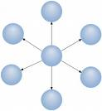
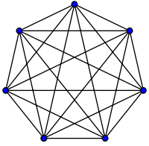
Peer-to-peer vs. Client-server
Because the entire game simulation runs at once on a single computer, client/server games are less likely to suffer from consistency problems.
Because all decisions are made on a single server, it is harder for hackers to cheat by modifying their client game executables.
The server must send information about every player to every client, thus sending a total of (playerCount * (playerCount − 1)) state descriptions. For comparison, in a peer-to-peer game, each computer only sends its own state to its peers, thus sending a total of (playerCount − 1) state descriptions.

Slide 26
Peer-to-peer vs. Client-server
The network bandwidth and CPU processing workload fall entirely onto a single server computer, which can easily become a processing bottleneck.
The network round trip to and from the server may cause players on client computers to experience lag in the game responding to their inputs.
Because the simulation state exists only on a single computer, supporting server migration if that computer goes away is more difficult than when using peer-to-peer networking.

Slide 27
Objectives
Basic concepts in multiplayer & online games
Game Architectures
Area of Interest Management
MMOGs business model
Game State and Dead Reckoning

Slide 28
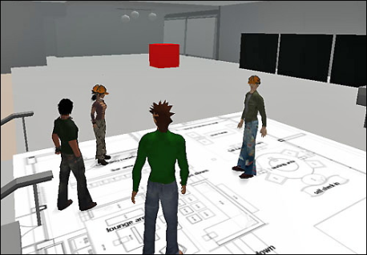
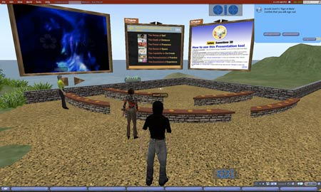
Area of Interest (AoI)
Interest management is a way of determining functional details of a player
Some models
Publisher-subscriber model
Spaced-based mode
Region based

Slide 29
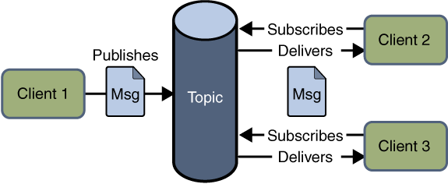
Area of Interest (cont.)
Publish-subscriber
Abstracting publish-subscribe model
Publishers (e.g. objects) create events
Subscribers (e.g. objects) get events
The most common domain is the visibility, but there are other domains like audible range, radar, etc.
http://da2i.univ-lille1.fr/doc/tutorial-javaee/JMS3.html

Slide 30
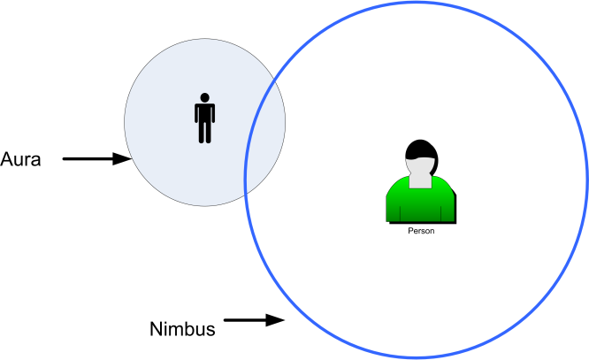
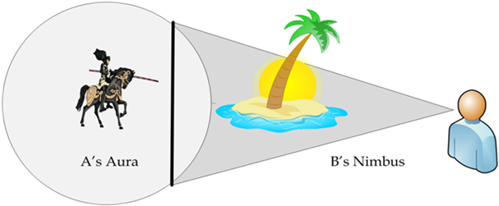
Area of Interest (cont.)
Spaced-based Interest Model
Based on proximity
Realized by aura-nimbus information model
The aura is the area that bounds the existence of an avatar in space
The nimbus, i.e. area of interest, is the space in which an object can perceive other objects.

Slide 31
Area of Interest (cont.)
Region-based Interest Model
Partition the world into several regions
The interest management determines the regions those intersect the expression of interest of the avatar, i.e. subscriber.
AoI is the union of the intersected regions with respect to expression of interest

Slide 32
Area of Interest (cont.)
Group communication (multicasting)
Application Layer Multicasting (ALM)
Easy deployable
Application specific multicast structure
Who cares multicast functionalities?
End-host
Routing shifts from Network layer to Application layer
R
R
R
R
R
R
R
R
IP multicasting
Application layer multicasting

Slide 33
Objectives
Basic concepts in multiplayer & online games
Game Architectures
Area of Interest Management
MMOGs business model
Game State and Dead Reckoning

Slide 34

MMOG Business Model
Increased cost of development
MUD1 24 person.month
Typical MMOG in 2004, 1400 person.month
Early hourly fees
Reduced later to attract more players
Monthly subscription
To attract more players and play time
1M in 2000 to 13M in 2006

Slide 35
Revenue Model – Free to play Games
Virtual Item Sales
Virtual item sales allowing users to purchase functional, decorative, or functional & decorative in-game items for use in and out of gameplay.
two currencies –
An attention currency - users earn virtual money via in-game activities
A real money-based currency - users buy virtual money using real money
First established in Korea
Nexon – makers of KartRider, MapleStory, and more
$230M of gross revenue in 2005 with 85% of that revenue coming from virtual item sales.

Slide 36
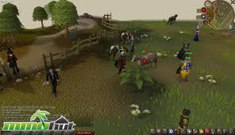

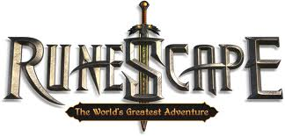
Revenue Model – Free to play Games
Subscription Tiers
A tiered subscription model allows users to play the core game for free, but those that desire access to elite weapons or other game content, must pay a small ($5/month) subscription fee.
What is the psychology?

Slide 37
Revenue Model – Free to play Games
Real Estate or "Land Use Fees”
Second Life is the biggest legitimate player utilizing this revenue model whereby virtual land is sold or leased to individuals.
Monthly lease fees range from $5 to $195, depending on the size of land in question.
Users may also purchase their own island for a one time fee of $1,675 in addition to a monthly fee of $295.
Advertising
Event or Tournament Fees
Donations
Auctions & Player Trades

Slide 38
Monetization
Credit card-based monthly subscription
CC may not be common in some countries or available to kids
Game time card
Pay-to-play
Game room model affects design
Micro-transaction
Buying items such as tools affects rewards

Slide 39
Customer Support
20-30 for thousands of users
Tools can reduce need for Customer Support
Automated help system
Teleportation for “stuck” players
Automated hardware profiling and configuration
Bug reporting systems

Slide 40
Some Technical Constraints
Latency
60ms for broadband and 200ms for dial-up
Will affect gameplay actions
Bandwidth
Gameplay data and also updates
AI
Not much done in MMOG
Limited programmers and costly server computation (worse in non-combat)

Slide 41
Objectives
Basic concepts in multiplayer & online games
Game Architectures
Area of Interest Management
MMOGs business model
Game State and Dead Reckoning

Slide 42
What Data to Send?
Sending entire world state is usually too much
Can send just user actions
Simulation engine does the same thing at each client

Slide 43
Prediction
Waiting for user inputs is too slow
Client does prediction
Motion prediction
Server corrects things if client is wrong

Slide 44
Dead Reckoning
Example: SIMNET (US Army Tank Simulator)
Each vehicle simulates own tank
Sends data every 5 seconds, updating
Position, Speed, Acceleration
Expected path
Prediction violation criteria
Receiver simulates own tank
AND simulates local copy of other tanks

Slide 45
Dead Recokoning
Receiver gets latest 5-second update
Updates own copy of other tanks
Predicts other tanks
Using prediction data
Until new data arrives
Each simulator also sends update
When own prediction violates own criteria
Assumes latencies < 500ms

Slide 46
Dead Reckoning
Sim A
Sim B
Sim A
Sim B
A’s Predicted Path
A’s Predicted Path
B’s Predicted Path
B’s Predicted Path
Predict B
Predict A
Predict B
Predict A
Transmit new prediction every 5 seconds
B Exceeds prediction: predict again and transmit

Slide 47
Latency Issues
When latencies get high
Prediction gets worse and worse
Correcting prediction errors may cause visual jumps (aka Lag Skips)
Easy to notice!
If jumps are large enough
Temporarily interpolate between wrong prediction and new correction

Slide 48
Prediction Interpolation
Interpolated
Response
Real
Predicted

Slide 49
Questions
What makes MMOG structure different from other games?
What are the most important technological issues in MMOG?
What are Client-Server and Peer-to-Peer network structures?
What is Virtual Economy in MMOG? Consider Trading, inflation, etc.
What is the Business Model in MMOG? How do they make money? How do people pay?
What are Customer Support issues in MMOG and how can the cost be reduced?
What are the security issues with MMOG?

Slide 50
References
Online Game Development
Rick Hall & Jeannie Novak
Delmar, 2008
Play Between Worlds: Exploring Online Game Culture
T. L. Taylor
MIT Press, 2006
I, Avatar
Mark S. Meadows
New Riders, 2008
Credit also goes to other online sources.

Slide 51
Thank you!

